Slide 1
AI Mentorship
Intermediate Python
FINAL PROJECT

Slide 2

DATASET A
Airbnb, Inc. adalah perusahaan pasar online persewaan liburan Amerika yang berbasis di San Francisco, California.
Airbnb mengelola dan menyelenggarakan pasar, yang dapat diakses oleh konsumen di situs webnya atau melalui aplikasi.

Slide 3

1. What inside this “Airbnb” dataset ?

Slide 4
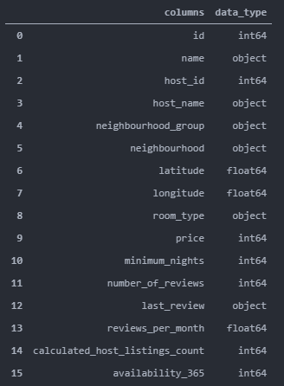
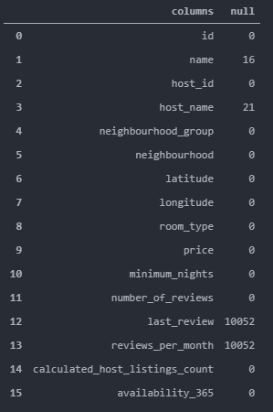
2. Properties in each column
With,
16 Columns
48895 Rows
Range Index,
from 0 to 48894

Slide 5
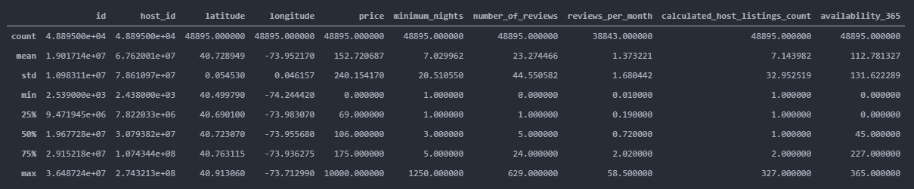
3. Amount of data, mean, median and std

Slide 6

4. Maximum and Minimum of the “Price”
Max Price = 10000
Min Price = 0

Slide 7
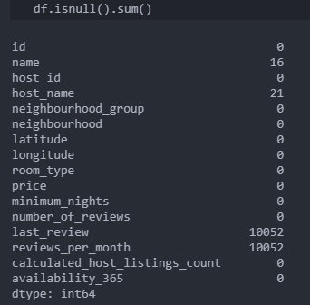
5. Handling missing value

Slide 8
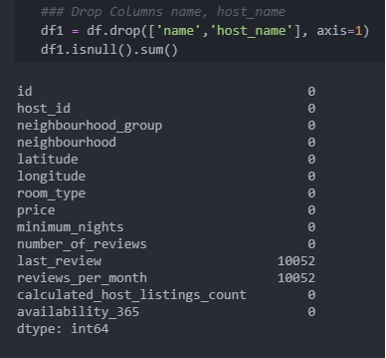
5. Handling missing value
First, drop missing value of the Columns that contains Non - Logical Value

Slide 9
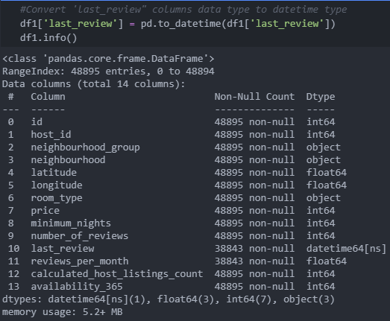
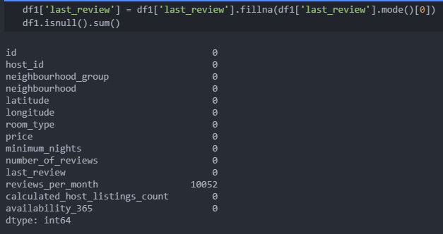
5. Handling missing value
Second, Fill the missing value in last_review with the most common date

Slide 10
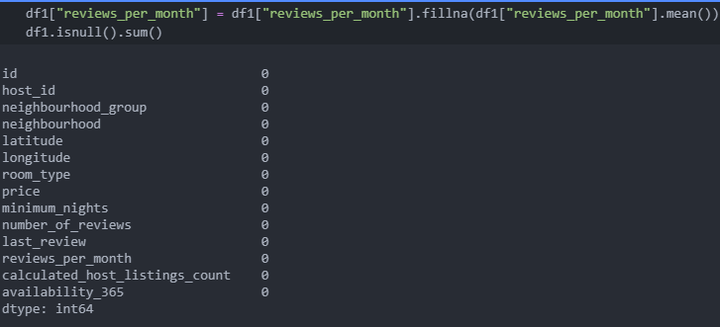
5. Handling missing value
Third, Fill the missing value in reviews_per_month with the mean

Slide 11
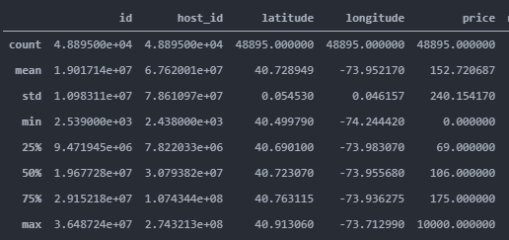
6. Make category based on the price: Cheap, Medium, and Expensive

Slide 12
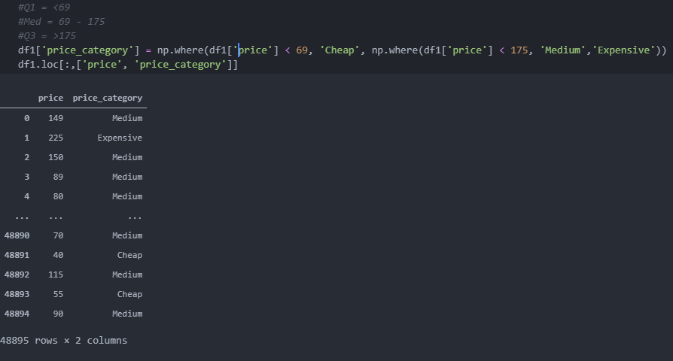
6. Make category based on the price: Cheap, Medium, and Expensive

Slide 13
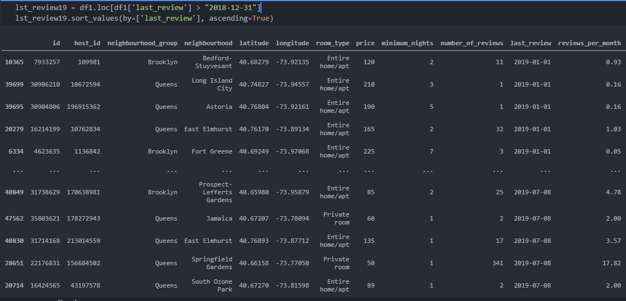
7. Filter all data which has “last_review in” > 2019

Slide 14
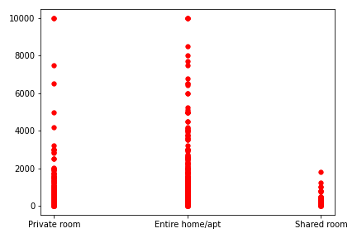
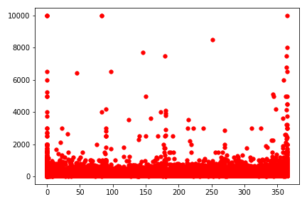
8. Visualize the price to compare the price of available rooms

